Slide 1
cypress.io
Best practices of automation in Cypress
Gustavo Souza

Slide 2
CONTENTS
There’s what you’ll find in this presentation:
Best Practices.
Chaining Assertions.
Global baseurl setup.
Page Object Model.
Reusable functions.
Constants.
Gustavo Souza

Slide 3
Chaining Assertions.
Add multiple assertions to a single command instead of multiple lines of code.
Gustavo Souza
Notes:
Its’ always better to add multiple assertions to a single command instead of multiple lines of code. Cypress runs a progression of async lifecycle occasions that reset state between tests. Resetting tests is much slower than including more statements

Slide 4
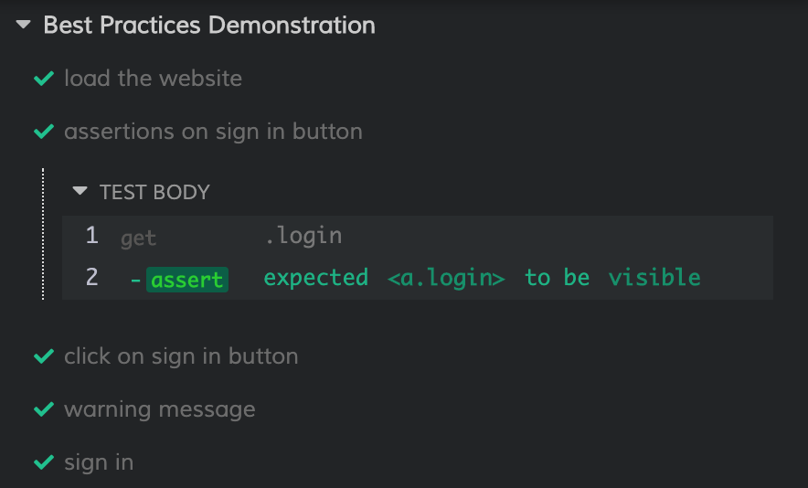
Chaining Assertions.
Not recommended practice: One assertion
Gustavo Souza

Slide 5
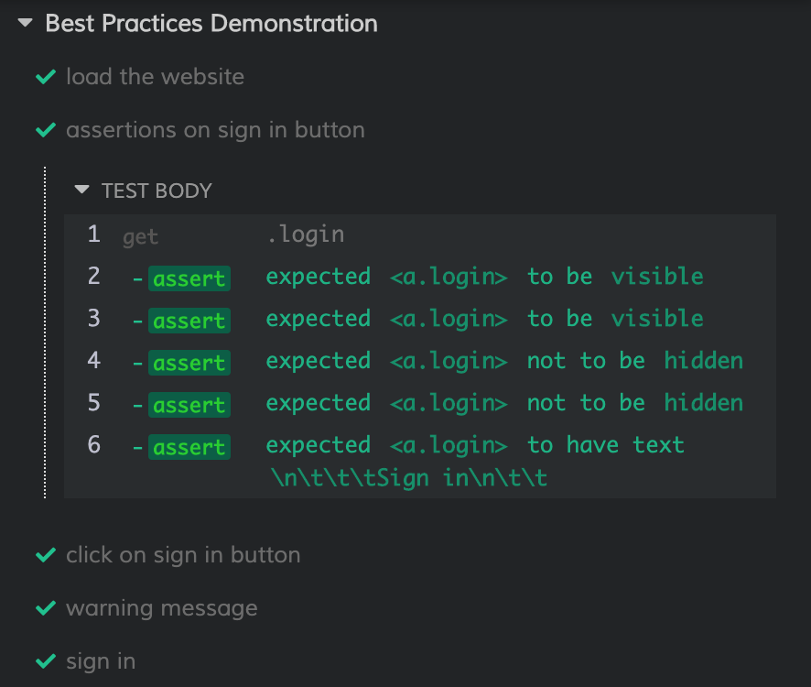
Chaining Assertions.
Best Practice: Multiple assertions
Gustavo Souza

Slide 6
Global baseurl setup.
Baseurl should be set up in cypress.json file instead of passing the URL to commands like cy.visit
(“http://automationpractice.com/index.php”) and
cy.request
(“http://automationpractice.com/index.php”).
Gustavo Souza
Notes:
Baseurl should be set up in cypress.json file instead of passing the URL to commands like cy.visit(“https://instapage.com/”) and cy.request(“https://instapage.com/”).

Slide 7
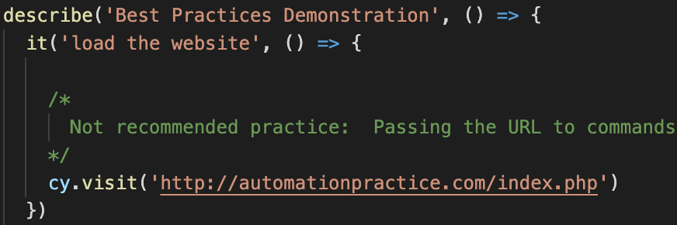
Global baseurl setup.
Not recommended practice: Passing the URL to commands
Gustavo Souza

Slide 8
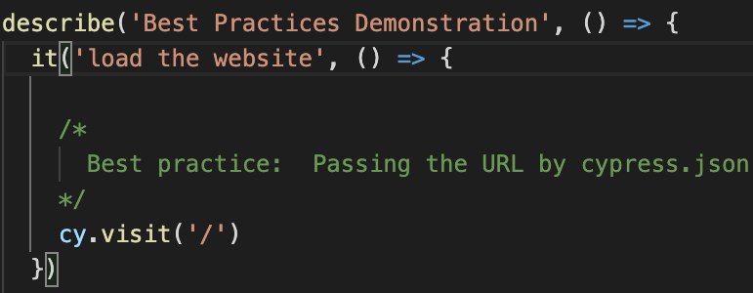
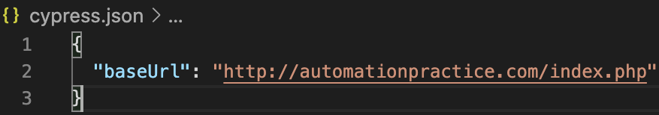
Global baseurl setup.
Best practice: Passing the URL by cypress.json
cypress.json
Gustavo Souza

Slide 9
Page Object Model.
POM is a design pattern that helps to enhance test maintenance and reduce code duplication.
Gustavo Souza

Slide 10
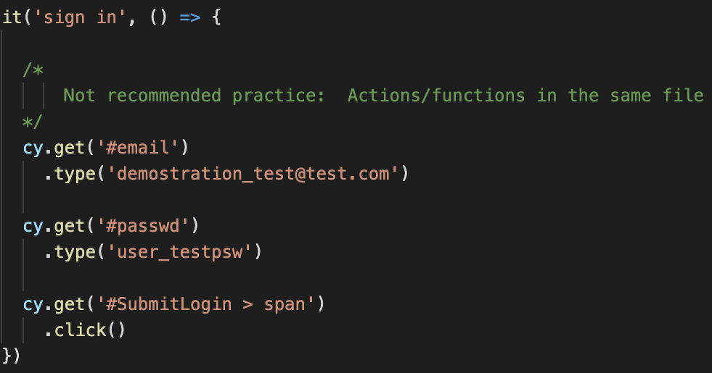
Page Object Model.
Not recommended practice: Actions/functions in the same file
Gustavo Souza

Slide 11
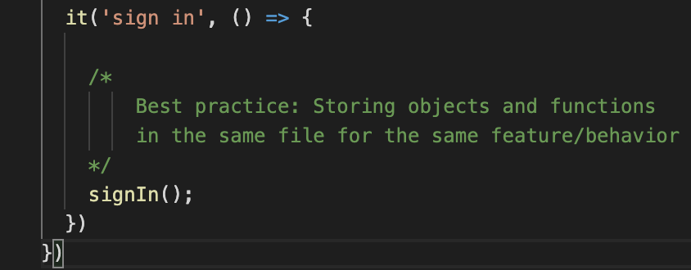
Page Object Model.
Best practice: Actions Best practice: Storing objects and functions in the same file for the same feature/behavior.
Gustavo Souza

Slide 12
Reusable functions.
Automation is more about reusability &
"Do not reinvent the wheel'' principle.
Gustavo Souza

Slide 13
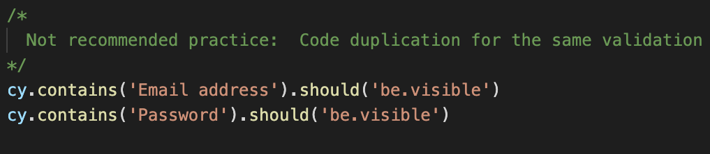
Reusable functions.
Not recommended practice: code duplication for the same validation.
Gustavo Souza

Slide 14
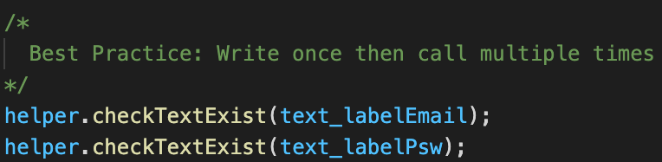
Reusable functions.
Best Practice: Write once then call multiple times.
.
Gustavo Souza

Slide 15
Constants.
Helpful to handle the assertion in the multiples texts displaying on the page.
Gustavo Souza

Slide 16
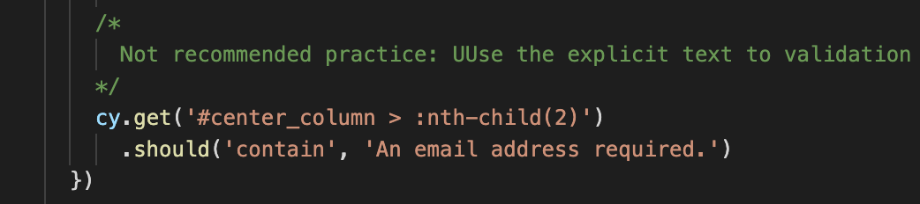
Constants.
Not recommended practice: Use the explicit text to validation.
Gustavo Souza

Slide 17
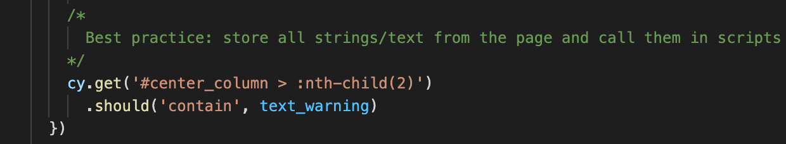
Constants.
Best practice: store all strings/text from the page and call them in scripts.
Gustavo Souza

Slide 18
THANKS!
Do you have any questions?
gustavo.souza@postclick.com
+55 11 94793-2353
Gustavo Souza

